Slide 1
Input / Output Organization

Slide 2
Overview
Computer has ability to exchange data with other devices.
  Human-computer communication
  Computer-computer communication
  Computer-device communication

Slide 3
Accessing I/O Devices

Slide 4
Single Bus
Processor
Memory
Bus
I/O de
vice 1
I/O de
vice
n
Figure 4.1. A single-bus structure.

Slide 5
Memory-Mapped I/O
When I/O devices and the memory share the same address space, the arrangement is called memory-mapped I/O.
Any machine instruction that can access memory can be used to transfer data to or from an I/O device.
Move DATAIN, R0
Move R0, DATAOUT
Some processors have special In and Out instructions to perform I/O transfer.

Slide 6
ISOLATED vs MEMORY MAPPED I/O
Isolated I/O
- Separate I/O read/write control lines in addition to memory read/write control lines
- Separate (isolated) memory and I/O address spaces
- Distinct input and output instructions
Memory-mapped I/O
  - A single set of read/write control lines
  (no distinction between memory and I/O transfer)
  - Memory and I/O addresses share the common address space
  -> reduces memory address range available
  - No specific input or output instruction
  -> The same memory reference instructions can
  be used for I/O transfers
  - Considerable flexibility in handling I/O operations

Slide 7
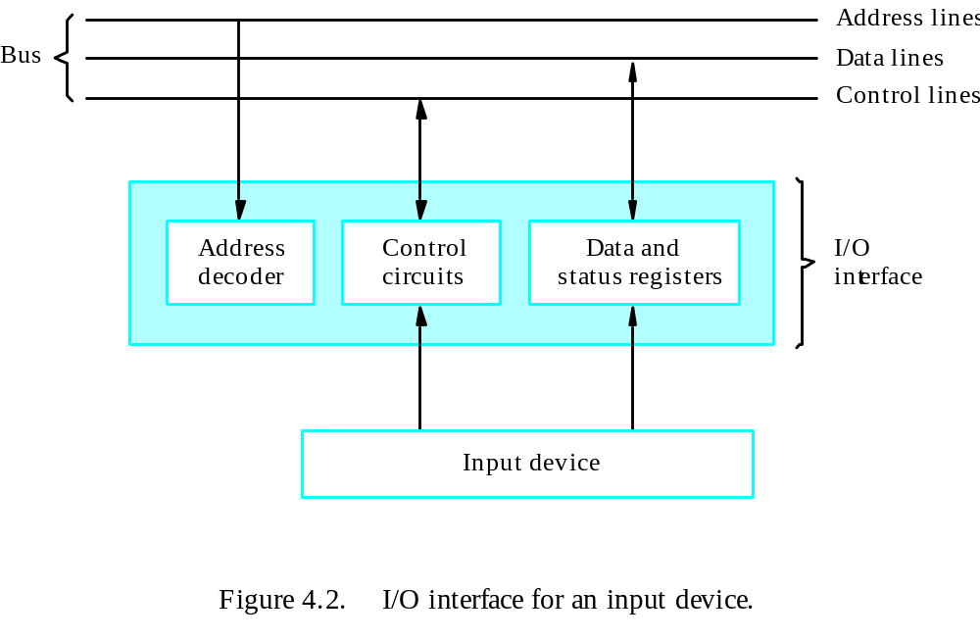
Interface

Slide 8
I/O INTERFACE
Port A
I/O data
register
Bidirectional
Bus
data bus
buffers
Port B
I/O data
register
CPU
Chip select
I/O
Device
CS
Internal bus
Register select
RS1
Timing
Control
Control
Register select
register
RS0
and
I/O read
Control
RD
Status
Status
I/O write
WR
register
CS RS1 RS0 Register selected
0 x x None - data bus in high-impedence
1 0 0 Port A register
1 0 1 Port B register
1 1 0 Control register
Programmable Interface
1 1 1 Status register
- Information in each port can be assigned a meaning
depending on the mode of operation of the I/O device
-> Port A = Data; Port B = Command; Port C = Control; Port D = Status
- CPU initializes(loads) each port by transferring a byte to the Control Register
-> Allows CPU can define the mode of operation of each port
-> Programmable Port: By changing the bits in the control register, it is possible to change the interface characteristics

Slide 9
ASYNCHRONOUS DATA TRANSFER
Synchronous and Asynchronous Operations
Asynchronous Data Transfer
Synchronous - All devices derive the timing information from common clock line
Asynchronous - No common clock
Asynchronous data transfer between two independent units requires that
control signals be transmitted between the communicating units to
indicate the time at which data is being transmitted
Two Asynchronous Data Transfer Methods
Strobe pulse
A strobe pulse is supplied by one unit to indicate the other unit when the transfer has to occur
Handshaking
A control signal is accompanied with each data being transmitted to indicate the presence of data
The receiving unit responds with another control signal to acknowledge receipt of the data

Slide 10
HANDSHAKING
Source-Initiated
The source unit that initiates the transfer has
no way of knowing whether the destination unit
has actually received data
Destination-Initiated
The destination unit that initiates the transfer
no way of knowing whether the source has
actually placed the data on the bus
To solve this problem, the HANDSHAKE method
introduces a second control signal to provide a Reply
to the unit that initiates the transfer

Slide 11
Three Major Mechanisms
Program-controlled I/O – processor polls the device.
Interrupt
Direct Memory Access (DMA)

Slide 12
Program-Controlled I/O
I/O devices operate at speeds that are very much different from that of the processor.
Keyboard, for example, is slower in speed than processor.
In this method, the processor constantly checks the status flags, and when it finds that the flag is set it performs the appropriate operation.

Slide 13
Interrupts

Slide 14
Overview
In program-controlled I/O, the program enters a wait loop in which it repeatedly tests the device status. During the period, the processor is not performing any useful computation.
However, in many situations other tasks can be performed while waiting for an I/O device to become ready.
Let the device alert the processor.

Slide 15
Enabling and Disabling Interrupts
Since the interrupt request can come at any time, it may alter the sequence of events from that predicted by the programmer.
Interrupts must be controlled.

Slide 16
Enabling and Disabling Interrupts
The interrupt request signal will be active until it learns that the processor has responded to its request. This must be handled to avoid successive interruptions.
Let the interrupt be disabled/enabled in the interrupt-service routine.
Let the processor automatically disable interrupts before starting the execution of the interrupt-service routine.

Slide 17
Vectored Interrupts
A device requesting an interrupt can identify itself by sending a special code to the processor over the bus.
Interrupt vector
Avoid bus collision

Slide 18
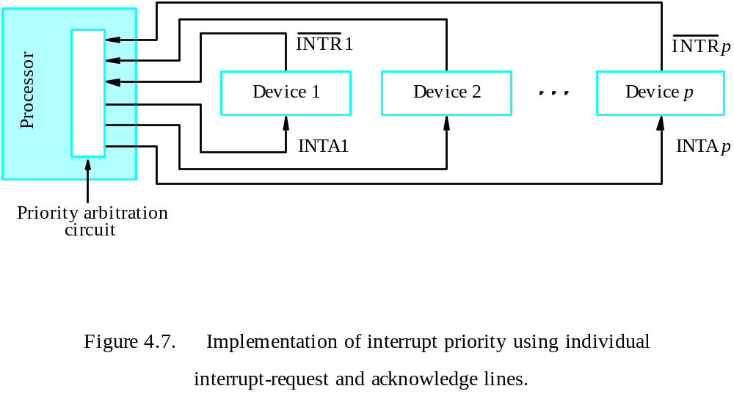
Interrupt Nesting
Simple solution: only accept one interrupt at a time, then disable all others.
Problem: some interrupts cannot be held too long.
Priority structure

Slide 19
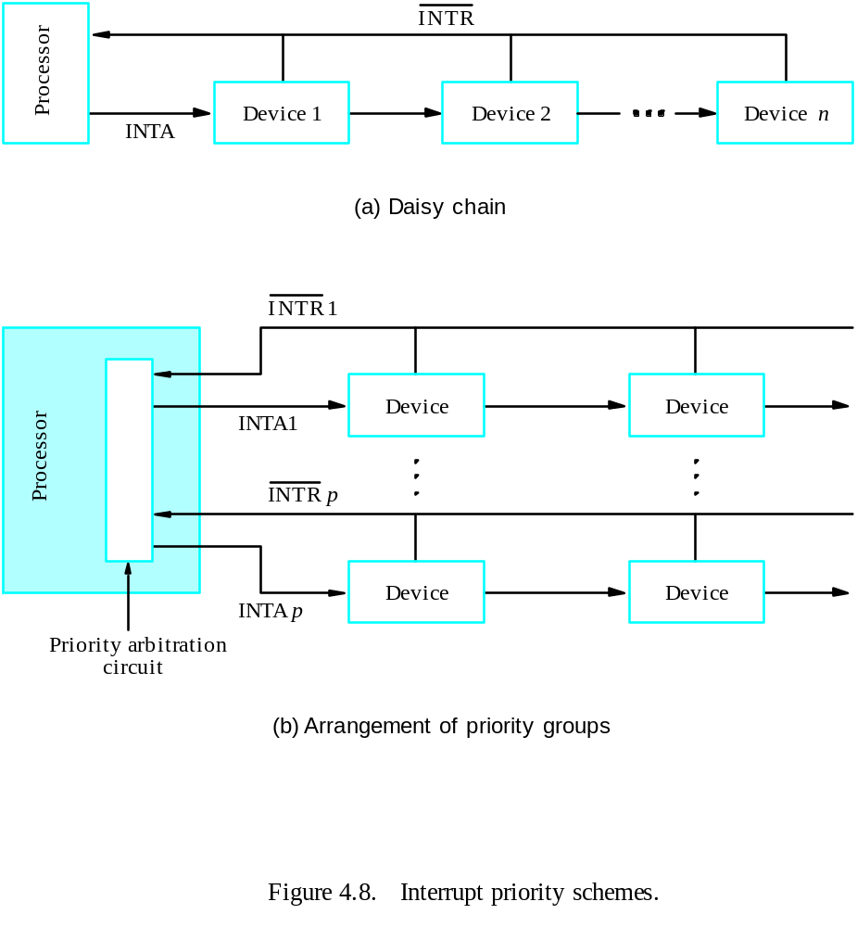
Simultaneous Requests

Slide 20
Controlling Device Requests
Some I/O devices may not be allowed to issue interrupt requests to the processor.
At device end, an interrupt-enable bit in a control register determines whether the device is allowed to generate an interrupt request.
At processor end, either an interrupt enable bit in the PS register or a priority structure determines whether a given interrupt request will be accepted.

Slide 21
Exceptions
Recovery from errors
Debugging
Trace
Breakpoint
Privilege exception

Slide 22
Use of Interrupts in Operating Systems
The OS and the application program pass control back and forth using software interrupts.
Supervisor mode / user mode
Multitasking (time-slicing)
Process – running, runnable, blocked
Program state

Slide 23
Processor Examples

Slide 24
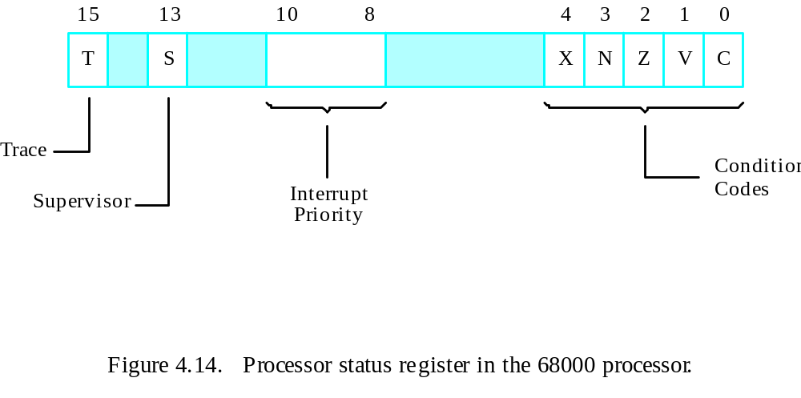

Slide 25
Direct Memory Access

Slide 26
DMA
A special control unit may be provided to allow transfer of a block of data directly between an external device and the main memory, without continuous intervention by the processor – direct memory access (DMA).
The DMA controller provides the memory address and all the bus signals needed for data transfer, increment the memory address for successive words, and keep track of the number of transfers.

Slide 27
DMA Procedure
Processor sends the starting address, the number of data, and the direction of transfer to DMA controller.
Processor suspends the application program requesting DMA, starts DMA transfer, and starts another program.
After the DMA transfer is done, DMA controller sends an interrupt signal to the processor.
The processor puts the suspended program in the ‘Run’ state.

Slide 28
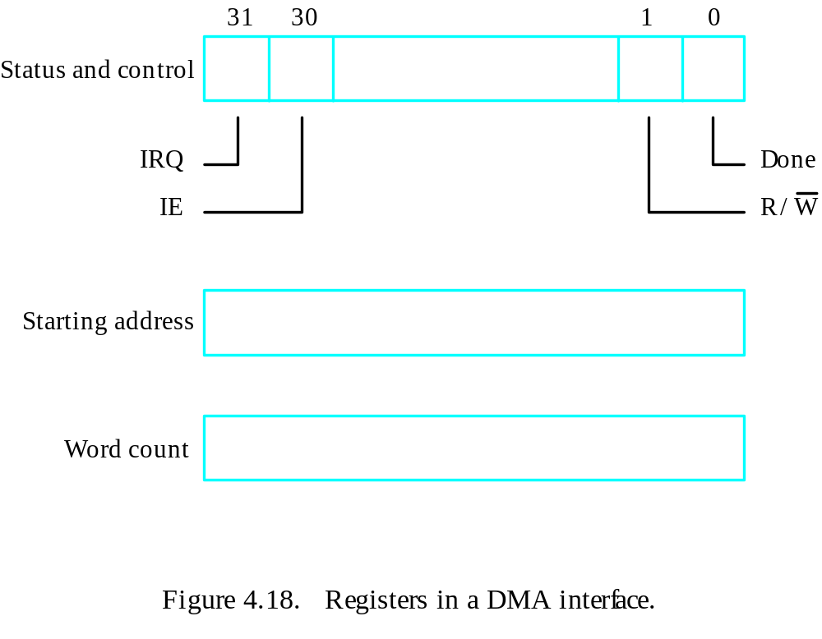
DMA Register

Slide 29
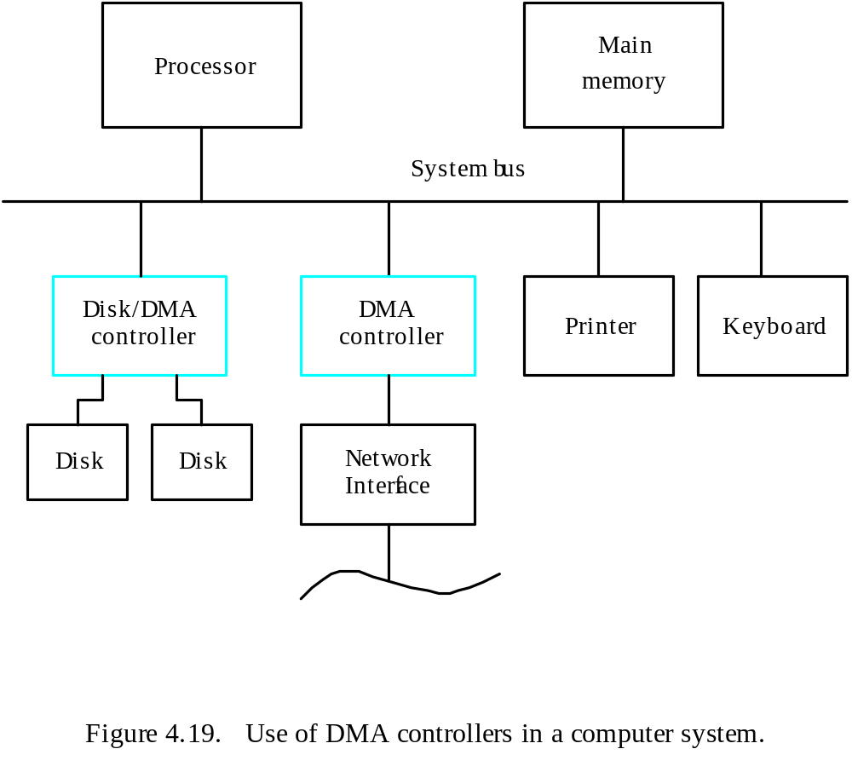
System

Slide 30
Memory Access
Memory access by the processor and the DMA controller are interlinked.
DMA device has higher priority.
Among all DMA requests, top priority is given to high-speed peripherals.

Slide 31
Bus Arbitration
The device that is allowed to initiate data transfers on the bus at any given time is called the bus master.
Bus arbitration is the process by which the next device to become the bus master is selected and bus mastership is transferred to it.
Need to establish a priority system.
Two approaches: centralized and distributed

Slide 32
Bus
The primary function of a bus is to provide a communications path for the transfer of data.
A bus protocol is the set of rules that govern the behavior of various devices connected to the bus as to when to place information on the bus, assert control signals, etc.
Three types of bus lines: data, address, control
The bus control signals also carry timing information.
Bus master (initiator) / slave (target)

